Slide 1




Introduction to Machine Learning Predictions
Dr Mengyan Zhang
NCI, Australia
University of Oxford

Slide 2
About me
Postdoctoral Researcher at the University of Oxford
PhD in Australian National University in Machine Learning
Research directions: sequential decision-making in machine learning

Slide 3
Course structure
Introduction to ML: predictions (Wed)
Introduction to ML: decision makings (Thu)
Case studies (Fri)

Slide 4
What is Machine Learning
Definition (Mitchell, 1998)
A computer program is said to
learn from experience E
with respect to some class of tasks T
and performance measure P,
if its performance at tasks in T, as measured by P, improves with experience E.

Slide 5
Cool Applications

Slide 6
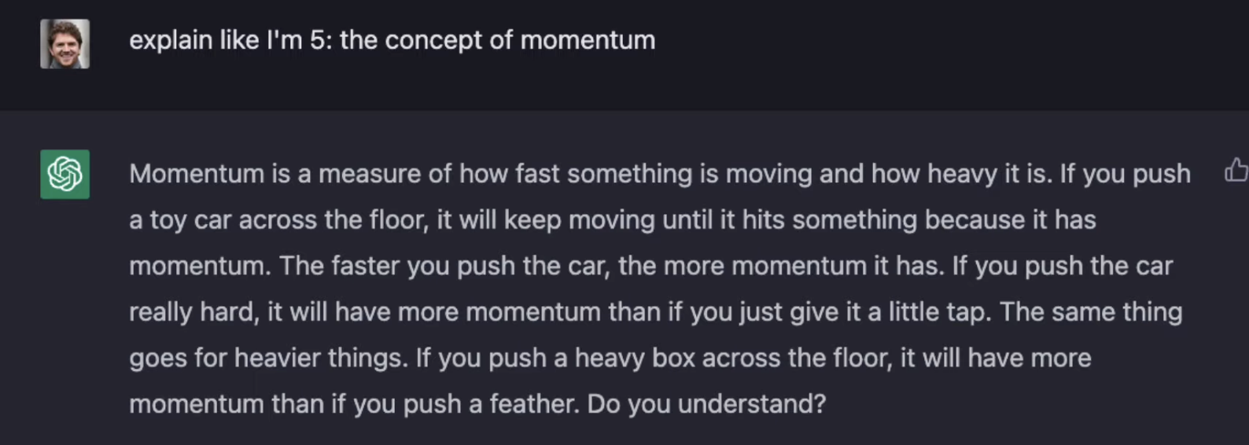

ChatGPT
Large language generative models
by OpenAI
https://www.youtube.com/watch?v=fgjoF97gdjQ

Slide 7

TicTok
Recommendation Systems:
User interactions
Video Information
Device and account settings
https://newsroom.tiktok.com/en-us/how-tiktok-recommends-videos-for-you

Slide 8
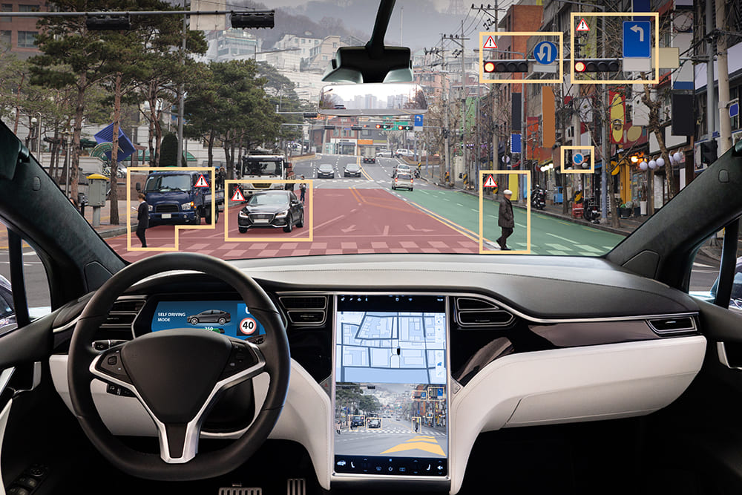
Self Driving Cars
Tesla’s approach -- “imitation learning.”: algorithms learn from the decisions, reactions, and movements of millions of actual drivers around the world.
https://bernardmarr.com/how-tesla-is-using-artificial-intelligence-to-create-the-autonomous-cars-of-the-future/

Slide 9
ML: categories
Predictions
Supervised
Unsupervised
Decision making
Bandits
Active Learning
Optimisation
…

Slide 10
Predictions

Slide 11

What we will cover
Applications
Supervised learning
Regression
Classification
Unsupervised learning: Clustering
Other types

Slide 12
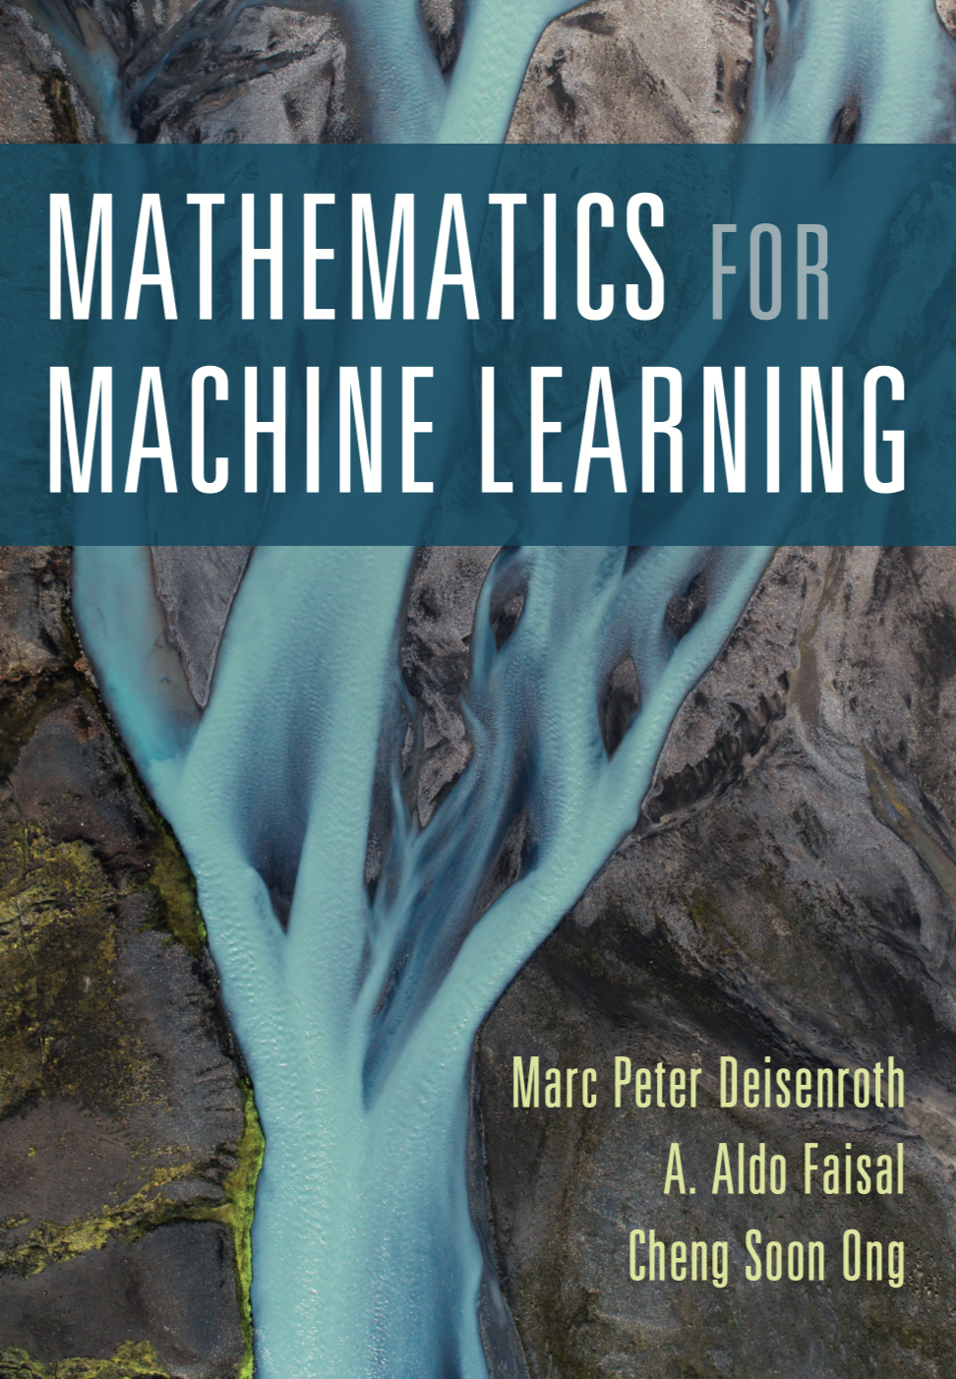

Textbook (if you’d like to learn more)

Slide 13
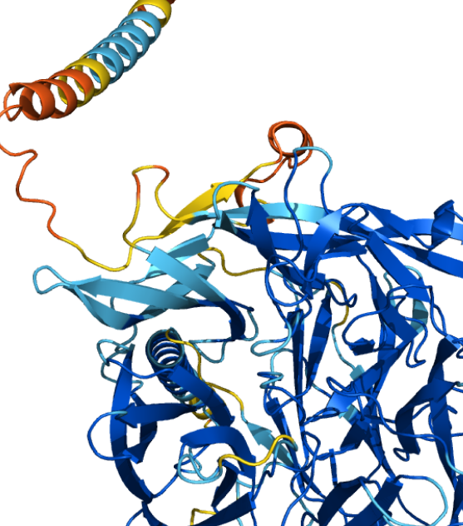
AlphaFold
AI system developed by DeepMind that predicts a protein’s 3D structure from its amino acid sequence
https://alphafold.ebi.ac.uk/

Slide 14
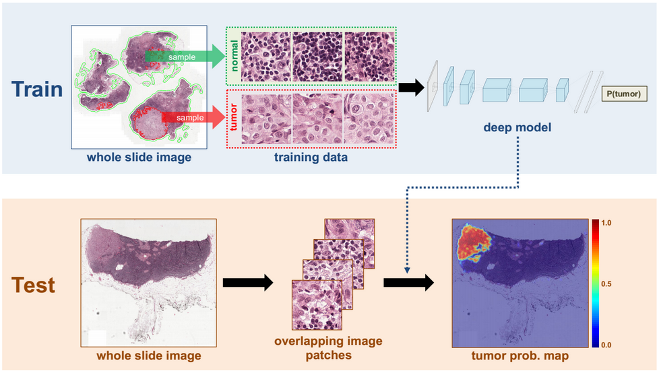
Cancer Classification
https://towardsdatascience.com/understanding-cancer-using-machine-learning-84087258ee18

Slide 15
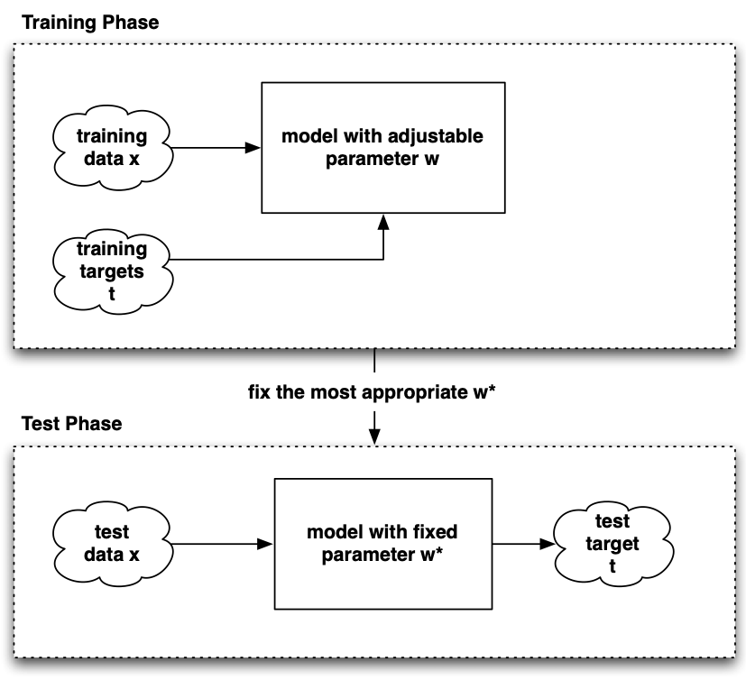
Supervised learning
(point estimation)

Slide 16
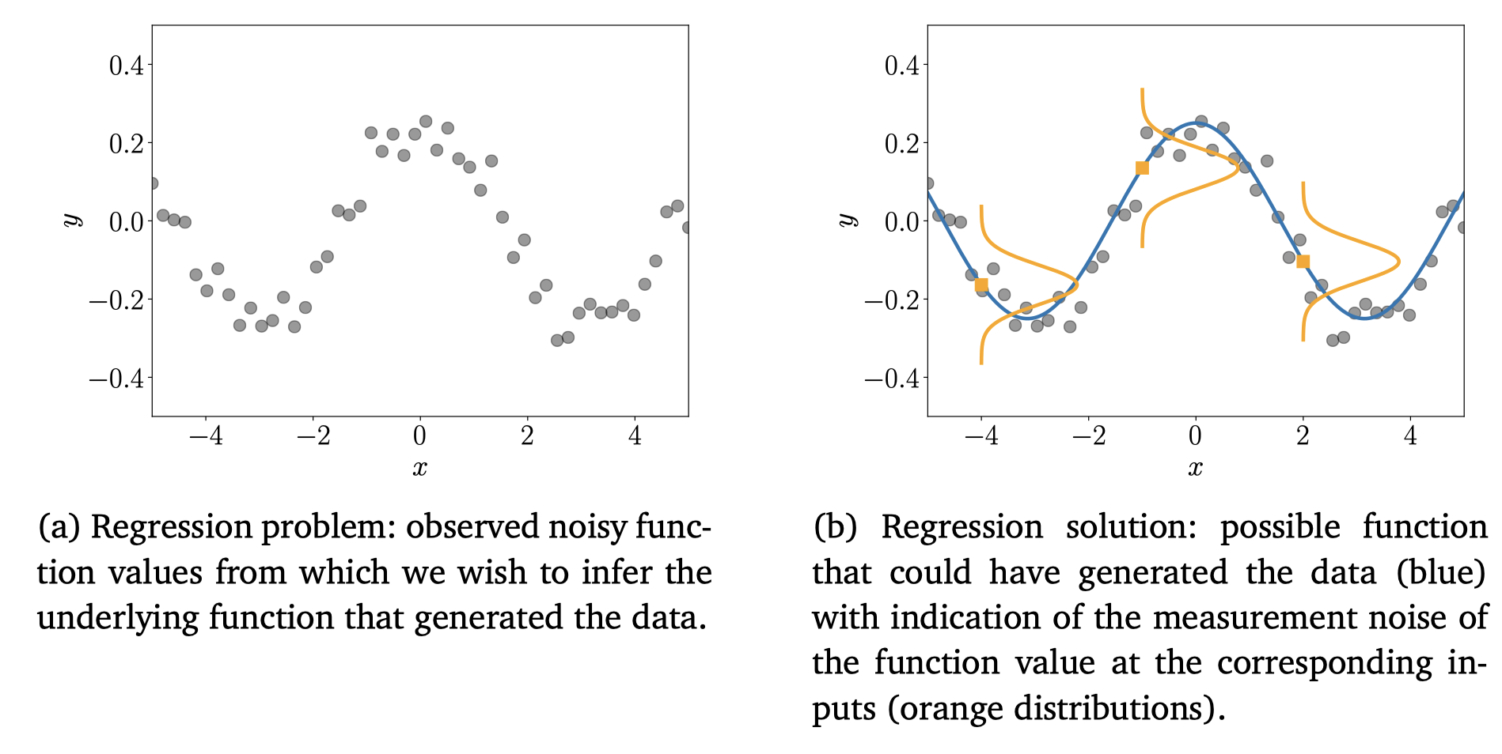
Linear Regression
mml book Fig 9.1

Slide 17
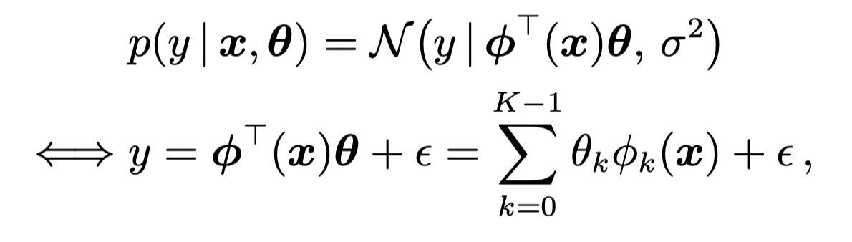
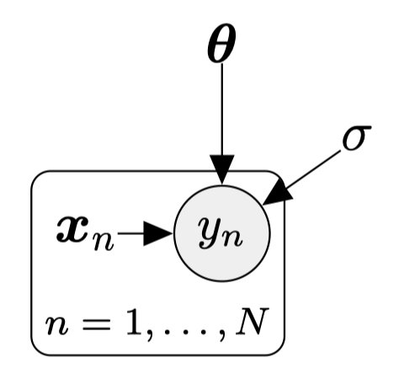
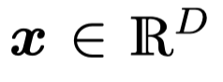
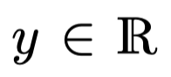
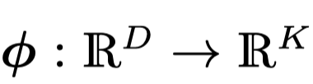
Linear Regression: Formulation

Slide 18
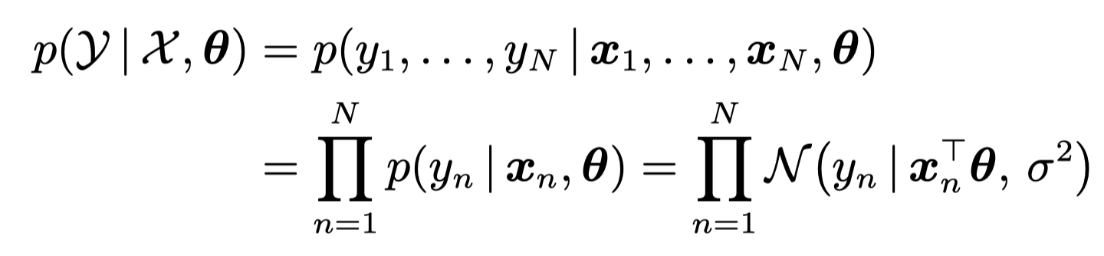
Linear Regression: Likelihood function

Slide 19
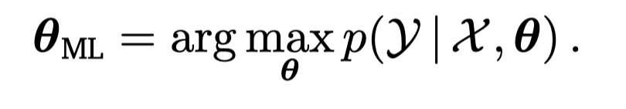
Linear Regression: Closed form solution
Maximum likelihood
= … (Check mml-book Section 9.2.1)

Slide 20
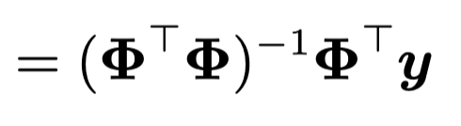
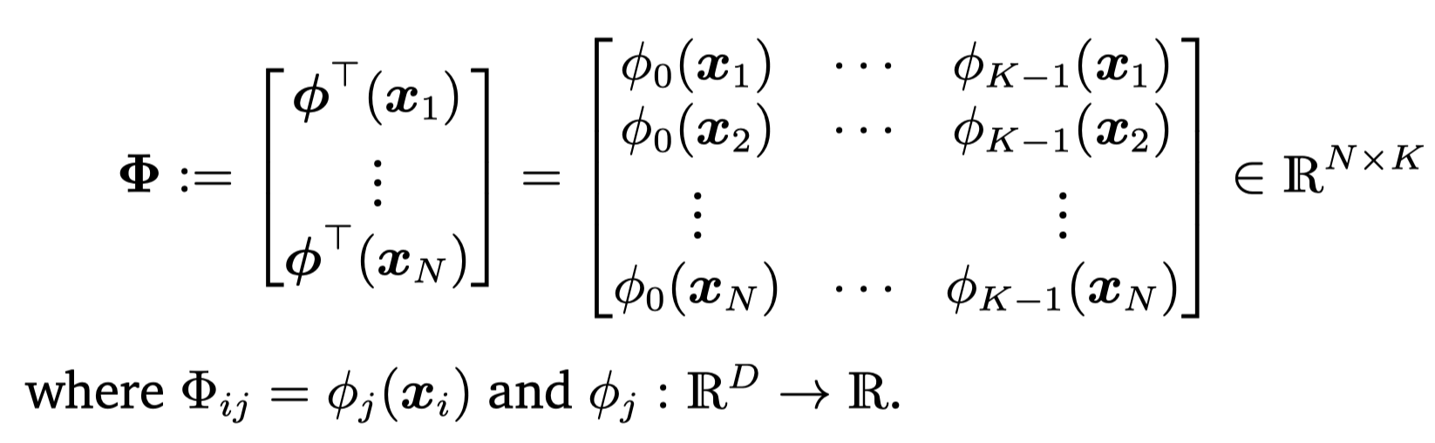
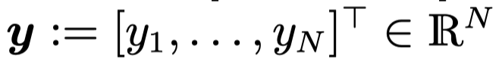
Linear Regression: Closed form solution
Maximum likelihood
= … (Check mml-book Section 9.2.1)

Slide 21
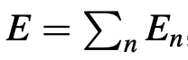
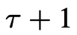
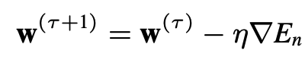
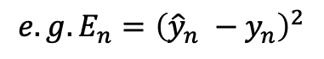
What if no closed form soluation? -- Stochastic Gradient Descent (SGD)
Step 1: design a loss (error) function (over data points)
Step 2: Minimise loss function via SGD
Start with random initialization of parameters
Update at iteration :
$${e.g. E}_{n}={\left({\hat{y}}_{n} −y_{n}\right)}^{2}$$
Learning rate

Slide 22
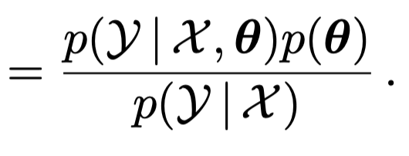

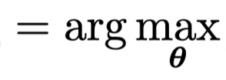
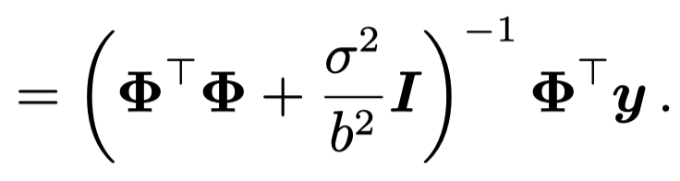
Linear Regression: Maximum a Posteriori Estimation
Links to regularization!

Slide 23
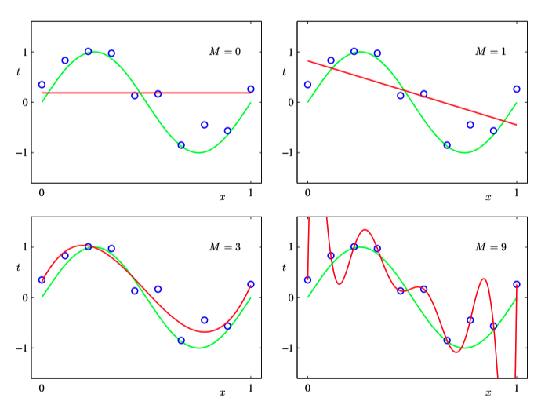
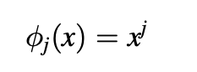
Example
Polynomial fit

Slide 24
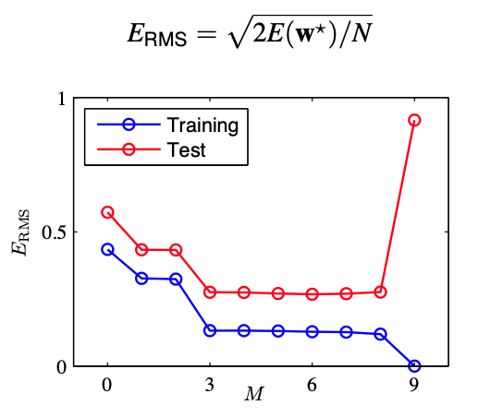
Evaluations
Train/Valid/Test Dataset Split
Root-Mean-Square (RMS) Error
Do not train on test data!

Slide 25
Neural Networks

Slide 26
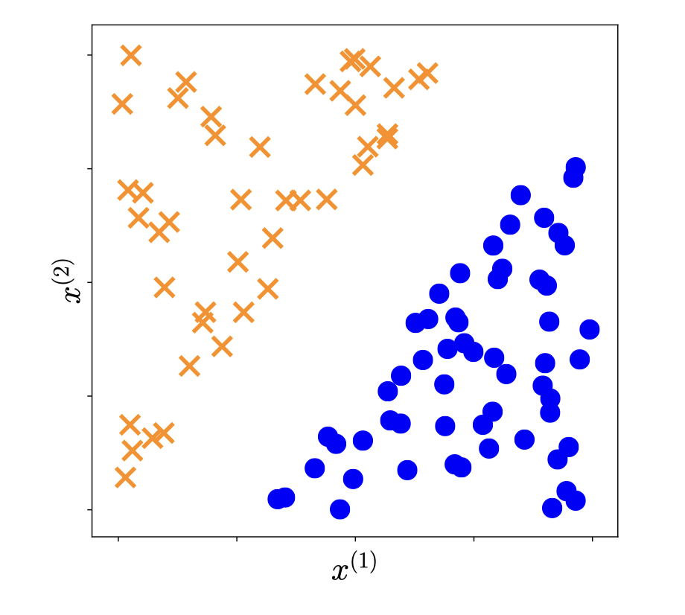
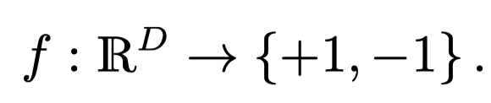
Supervised: classification
mml-book Fig 12.1

Slide 27
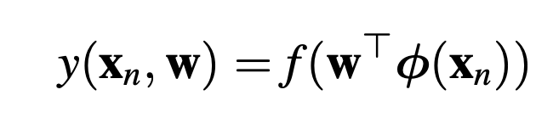
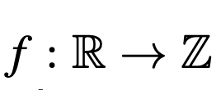

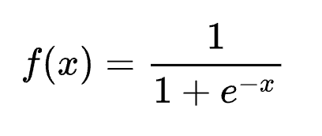
Classification – Generalised Linear Model
Activation function
e.g. sigmoid function

Slide 28
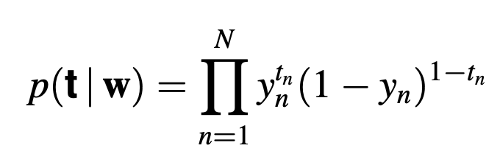
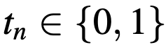
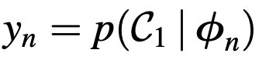
Logistic regression (it is a classification method!)
Likelihood function

Slide 29
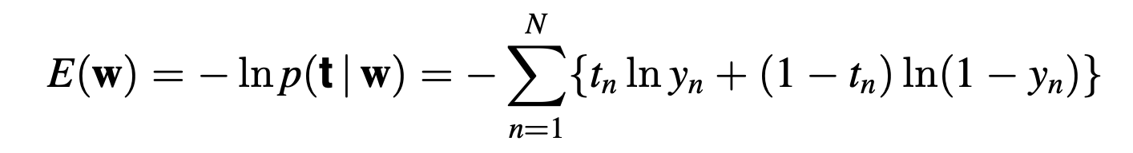
Logistic regression (it is a classification method!)
Likelihood function
Error function

Slide 30
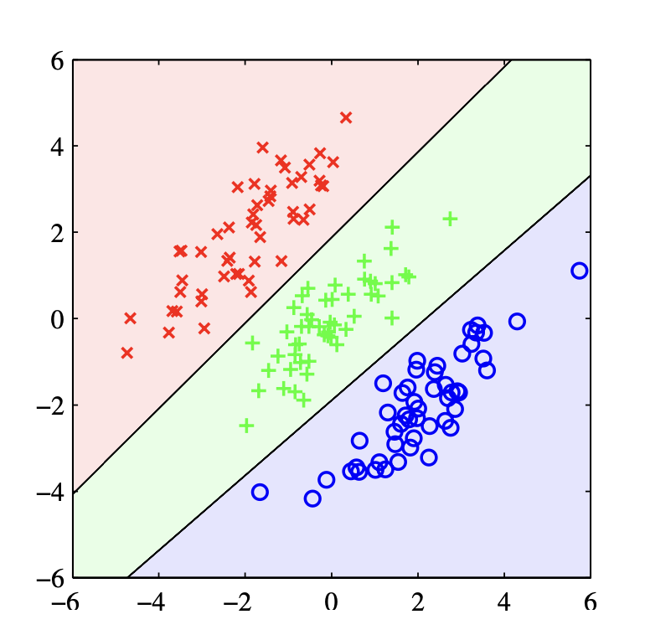
Example
PMLR Fig 4.5

Slide 31
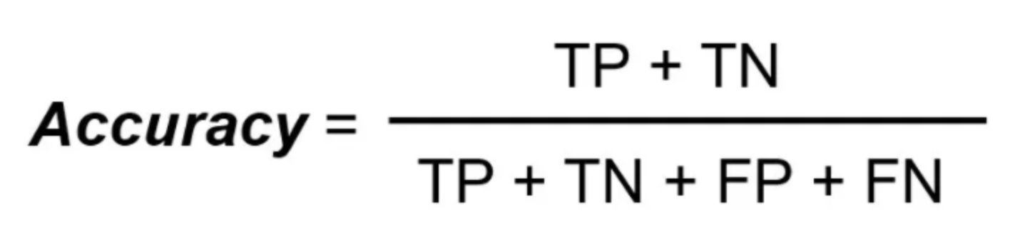
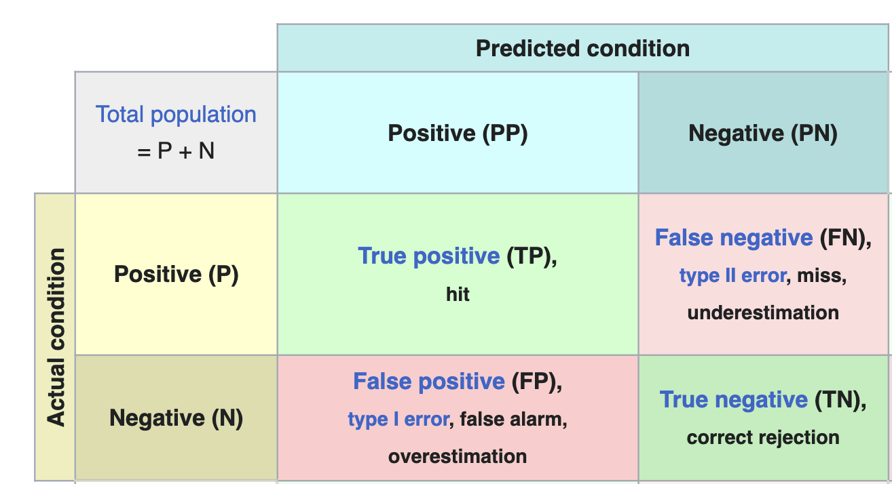
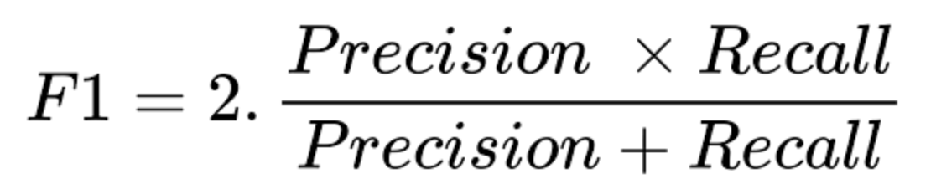

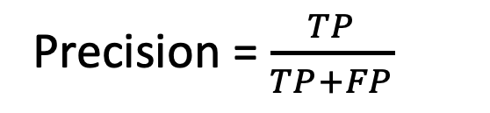
Evaluations
Not good for imbalanced data!
Precision = $\frac{TP}{TP+FP}$
Recall = $\frac{TP}{TP+FN}$

Slide 32
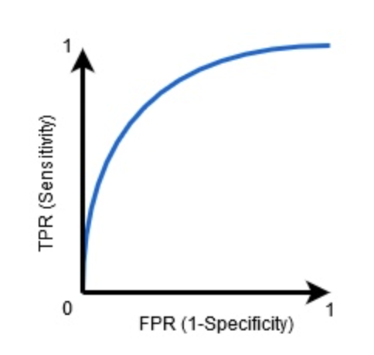
Evaluation: AUC – ROC curve
probability curve that plots the TPR against FPR at various threshold values and essentially separates the ‘signal’ from the ‘noise.’
shows the performance of a classification model at all classification thresholds
The higher the AUC, the better the model’s performance at distinguishing between the positive and negative classes.

Slide 33
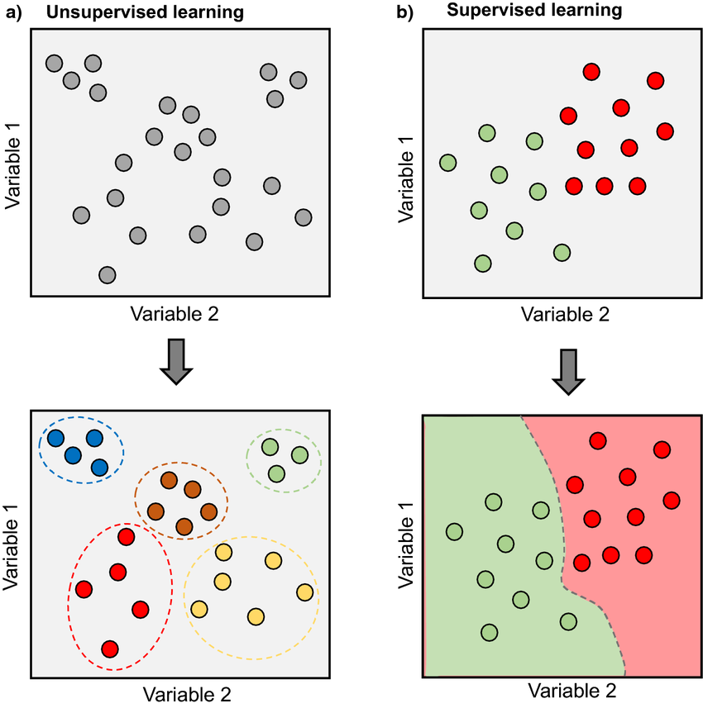
Unsupervised learning
Clustering
Goal: partition data into K clusters (set of similar data points), without labels!
https://www.researchgate.net/figure/Supervised-and-unsupervised-machine-learning-a-Schematic-representation-of-an_fig3_351953193

Slide 34
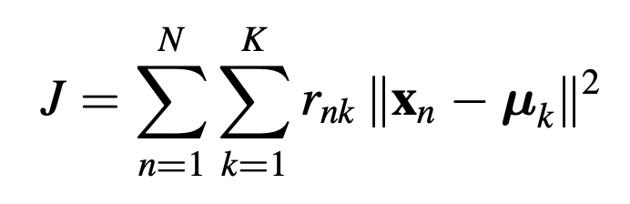
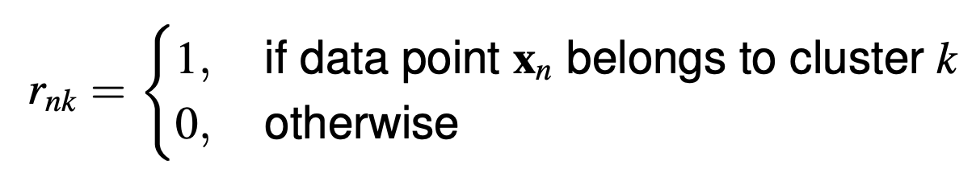
Clustering -- Kmeans

Slide 35
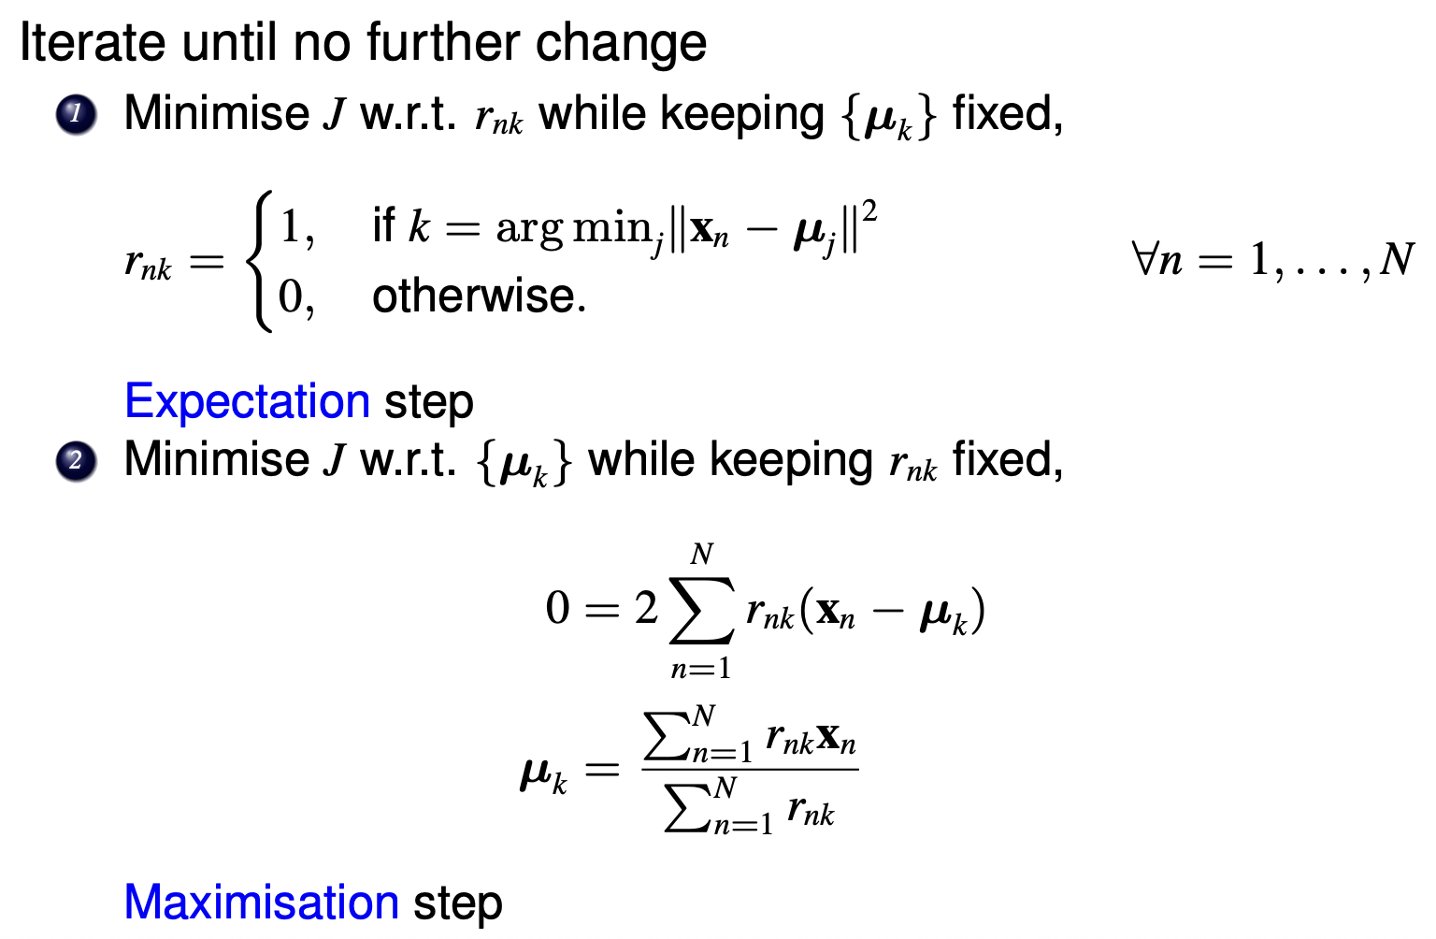
From slide of statistical machine learning course in ANU (2021)

Slide 36
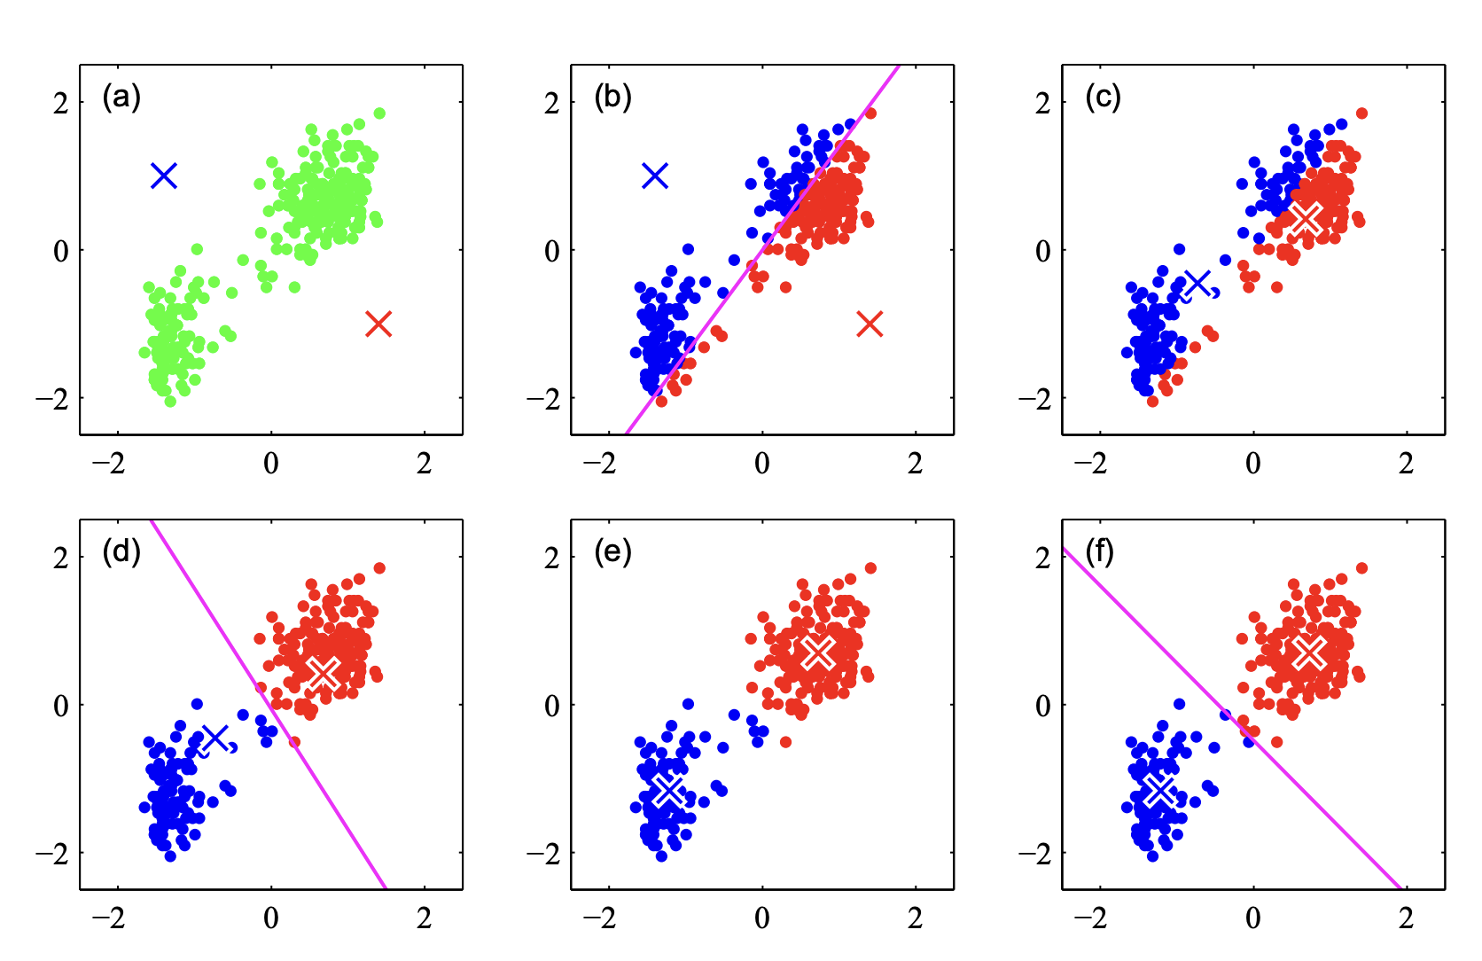
Kmeans Example
PRML book

Slide 37
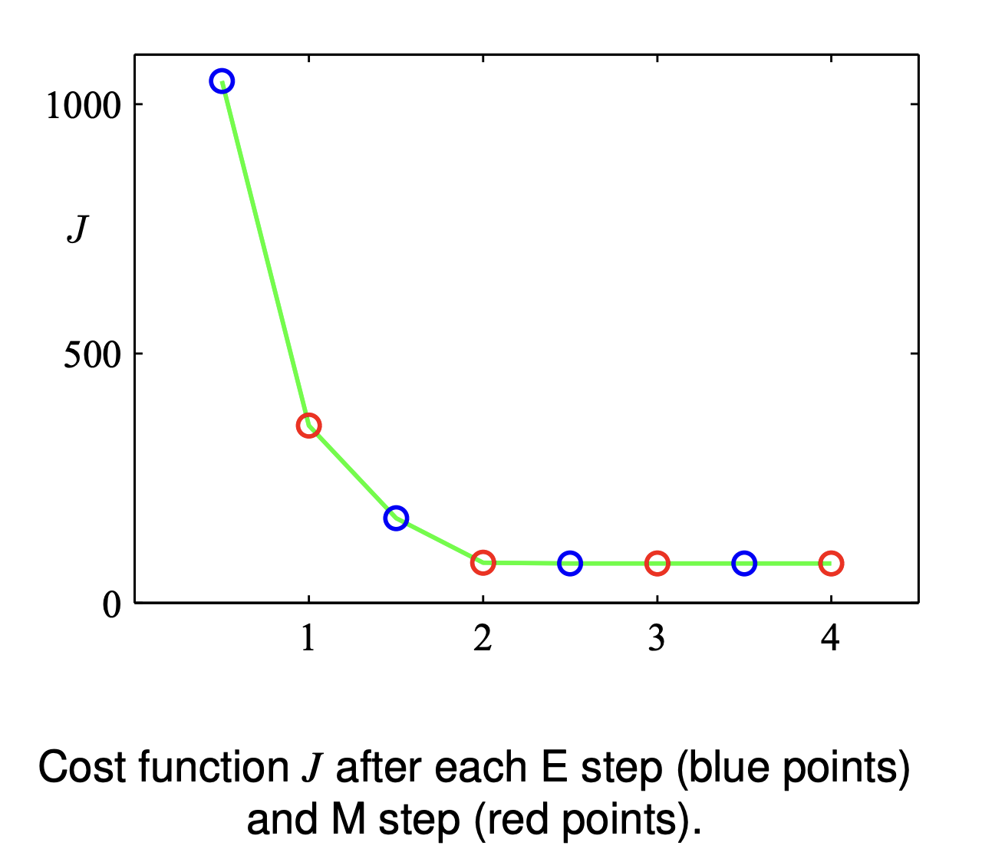
Kmeans Example

Slide 38
Other Types
Extension for Linear models
Kernelised method
Gaussain process
Neural networks
Bayesian approaches
Dimensionality Reduction
Graphical models
…

Slide 39
What is Machine Learning
Definition (Mitchell, 1998)
A computer program is said to
learn from experience E
with respect to some class of tasks T
and performance measure P,
if its performance at tasks in T, as measured by P, improves with experience E.

Slide 40
Summary: Predictions
Linear regression
Logistic regression (classification)
Clustering: Kmeans

Slide 41
Notebook
#!/bin/bash set -o nounset set -o pipefail set -o errexit
mkdir -p /scratch/vp91/${USER} cd /scratch/vp91/${USER}
git clone –b RMIT_NCI_workshop_2023 https://github.com/nci900/RMIT-NCI-Week
Go are.nci.org.au

